Slide 1

Maven Roasters Project 1
Enhance operational efficiency, sales performance
& provide recommendations

Slide 2
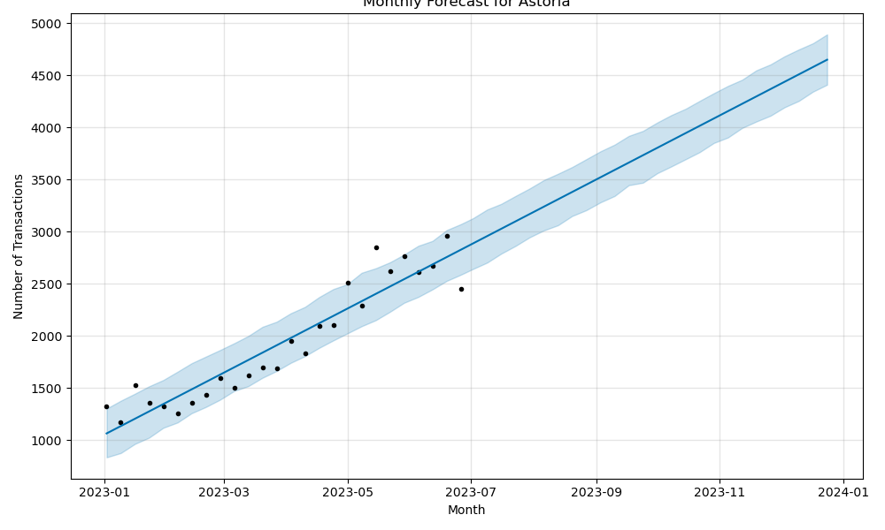
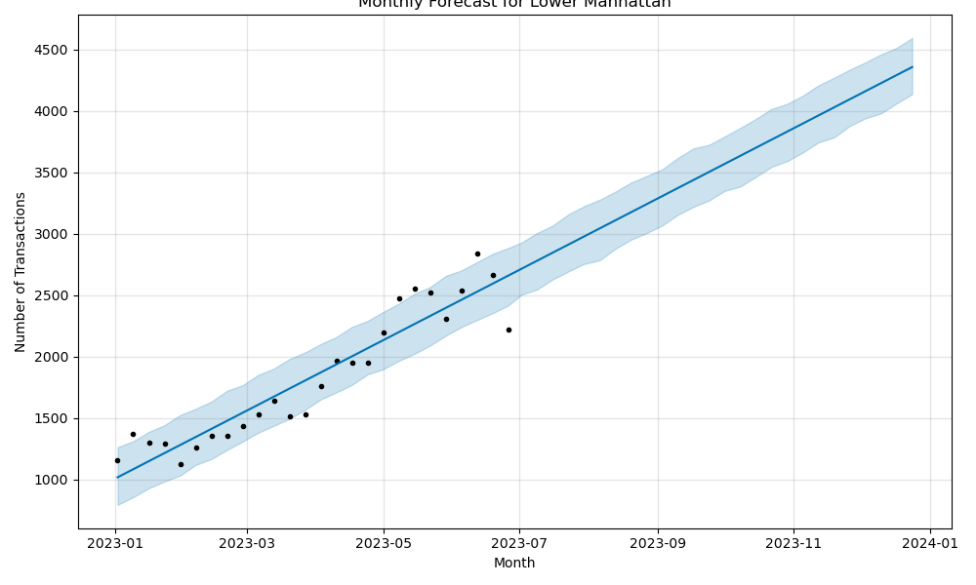
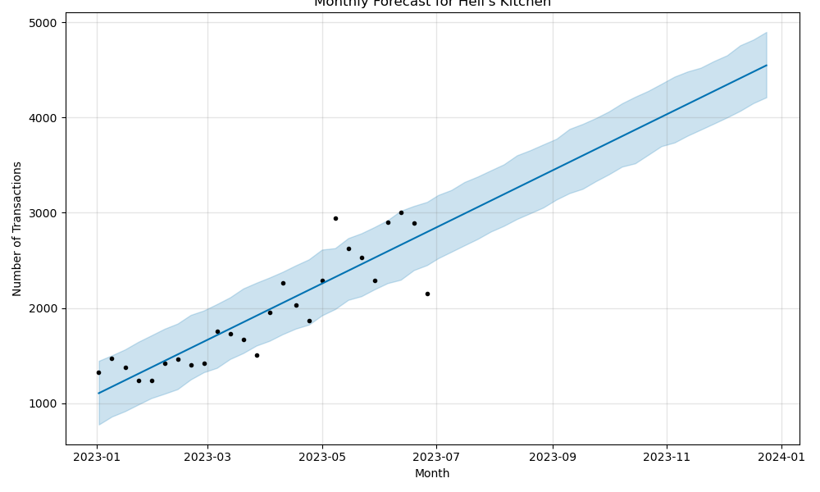
Data Prediction Limitations
The six-month sales data from Maven Coffee Shop, while useful for initial insights, poses a significant challenge for reliable future forecasting due to its limited scope. This time frame is too brief to fully capture the complex seasonal variations and market dynamics crucial for accurate long-term projections in the dynamic coffee shop industry. The data's indication of a linear upward trend may be misleading, as it oversimplifies potential market fluctuations, economic shifts, and changes in consumer behavior, all vital factors that can significantly impact sales. Therefore, Maven Coffee Shop should approach future predictions with caution, supplementing this limited dataset with broader market research and industry trends. This holistic approach, coupled with continuous refinement of forecasting models as more data becomes available, is essential for developing adaptable and informed business strategies.

Slide 3
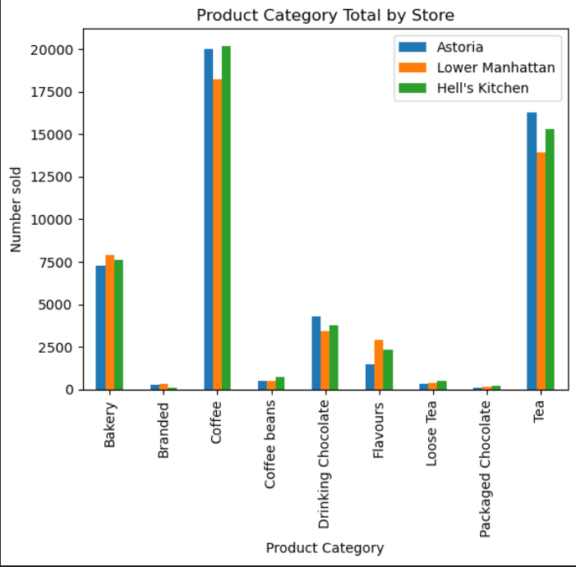

Best Sellers: Coffee

Slide 4
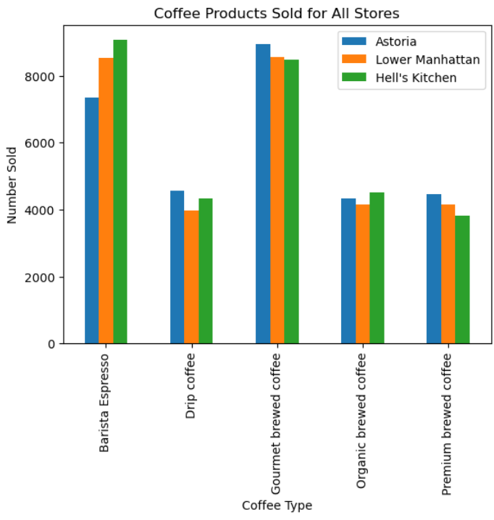
Identify coffee variations
Less popular:
Contributed to the overall sales
Diversification mitigate risks
Same, higher unit price

Slide 5
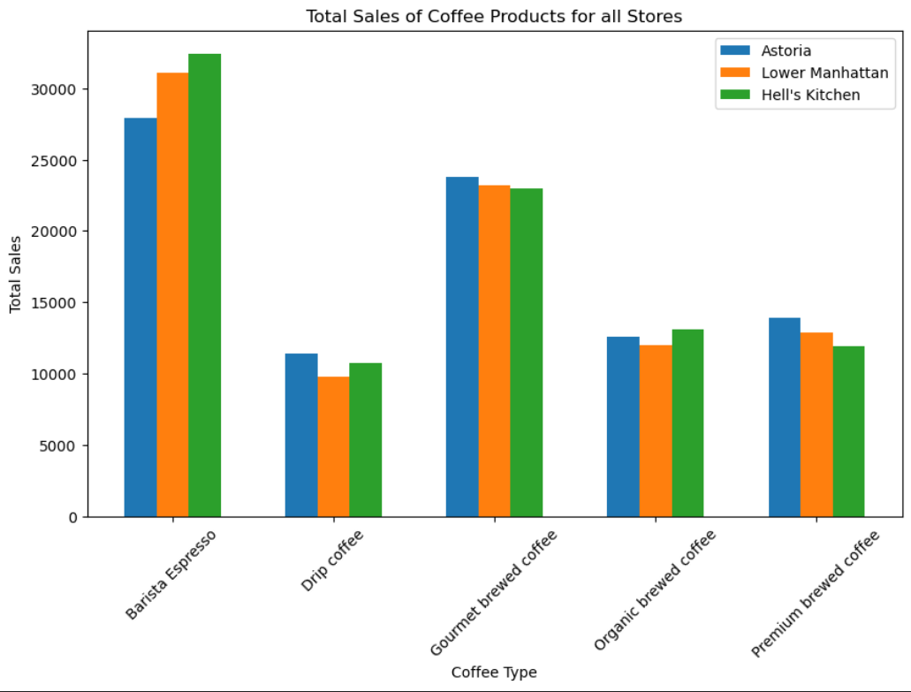
Total sales
Opportunities for top sellers:
Promote products with higher transaction quantities
Managing inventory
Opportunities for bottom sellers:
Why are these the lowest sellers
Need better promotions
Managing inventory
Recommendation:
Conduct a survey
Investigate price points and profit margins

Slide 6
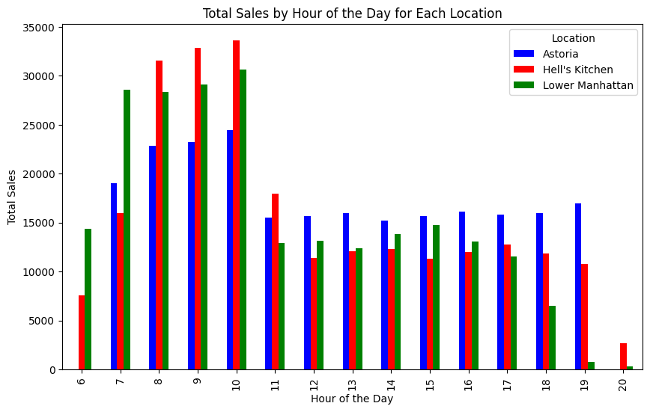
Sales by hour
All locations for the most part follow a similar pattern as the day progresses
This pattern is a spike in the early hours, with sales dropping at around 11a.m.
Astoria is the most consist throughout the day seeing a smaller peak while also not having a drop off in the later hours of the day
For staffing purposes this means that you would need a big opening crew in order to ensure that the morning rush goes smooth but you can let them off around 11am/noon and keep a smaller crew for the afternoon

Slide 7
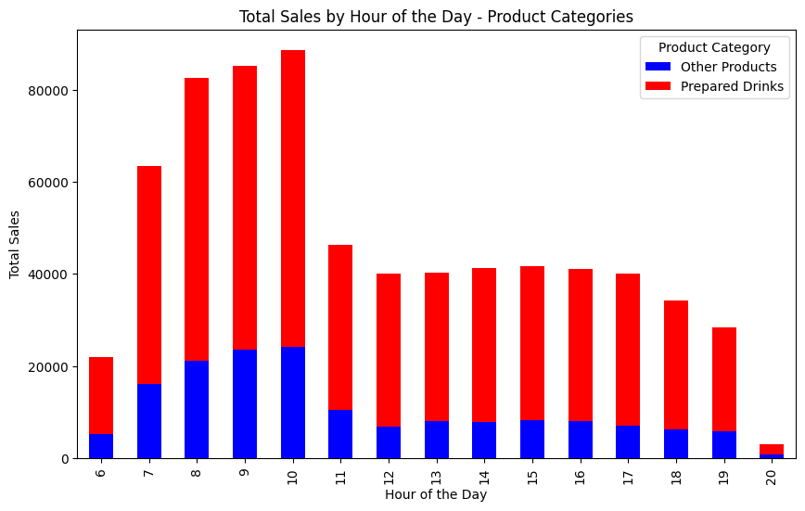
Sales by hour cont.
Another factor that is relevant to staffing would be the types of products sold
Certain products like coffee, tea and drinking chocolate would require a staff member to prepare
While other products such as coffee beans, flavours, etc. can just be bought off the shelf
We see that the sale of prepared drinks follows the same trend of having a large morning rush
Once that rush dies down, however, the large majority or the products sold are those that can just be purchased
This means that due to not having very many prepared drinks you can utilize an even smaller evening crew to maintain the shop.

Slide 8
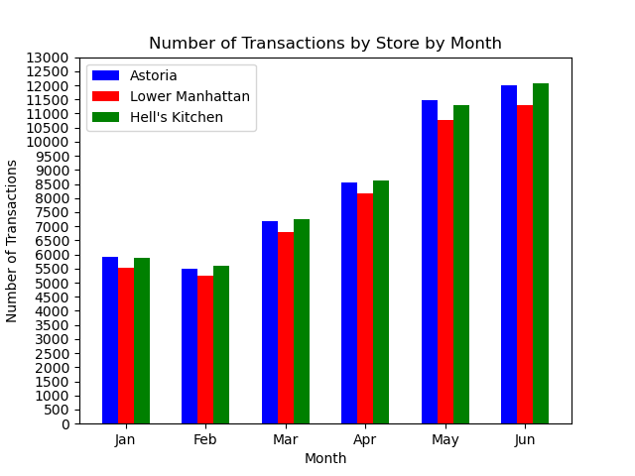
Monthly Transactions
In January 2023, Maven Coffee Shop's locations in Astoria, Lower Manhattan, and Hell's Kitchen started the year with a solid flow of customer transactions but experienced a slight dip in February, a common trend after the holiday season. The reduced activity can be attributed to typical post-holiday spending slowdowns and the colder New York City weather, which tends to discourage casual outings. Despite this, the consistent patronage in each location indicated a strong brand presence and a loyal customer base.
The transaction count at all three locations saw a significant uptick in March, with Astoria leading the surge, likely due to the arrival of warmer weather and increased tourist activity. This upward trend continued and even amplified in May, driven by factors such as the end of the academic year and the start of the tourist season, bringing a diverse mix of customers. These variations in customer traffic highlighted the need for Maven Coffee Shop to adopt flexible staffing strategies. Increasing part-time staff or adjusting schedules during peak times ensures efficient service without compromising quality. Effective management of these busier periods is crucial for maintaining customer satisfaction and capitalizing on the higher foot traffic.

Slide 9
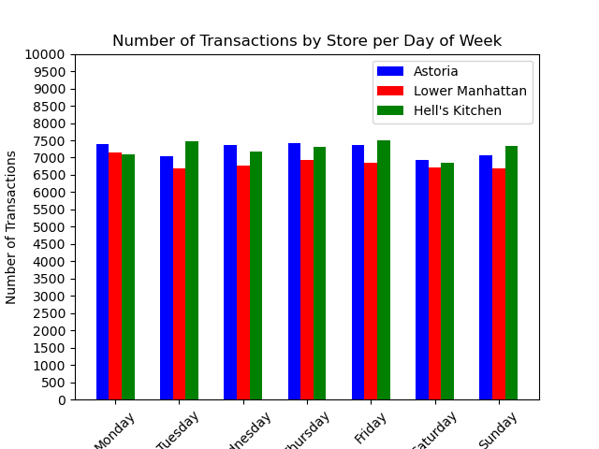
Transactions by Day of Week
At Maven Coffee Shop, the transaction patterns across the Astoria, Lower Manhattan, and Hell's Kitchen locations display an unusual but consistent trend: the number of daily transactions remains remarkably uniform throughout the week. This stability in customer flow, deviating from the typical industry norm of weekend spikes or weekday variations, suggests a steady patronage across all days. In Astoria, the diverse demographic mix of professionals, students, and residents contributes to this regularity, while in Lower Manhattan, the blend of office workers, tourists, and locals maintains a constant transaction level. Hell's Kitchen mirrors this trend, likely due to its residential stability and the continuous draw of nearby attractions.
This consistent daily transaction rate presents both operational advantages and strategic opportunities for Maven Coffee Shop. Operationally, the predictability aids in efficient staffing and inventory management, ensuring the business can run smoothly without the risks of overstaffing or stock shortages. Strategically, however, this pattern indicates potential areas for growth, particularly on days typically considered off-peak in the café industry. By tailoring marketing efforts and introducing specific promotions targeted at these days, Maven Coffee Shop could potentially increase its customer base and transaction count, capitalizing on opportunities that the current uniformity suggests are as yet untapped.

Slide 10
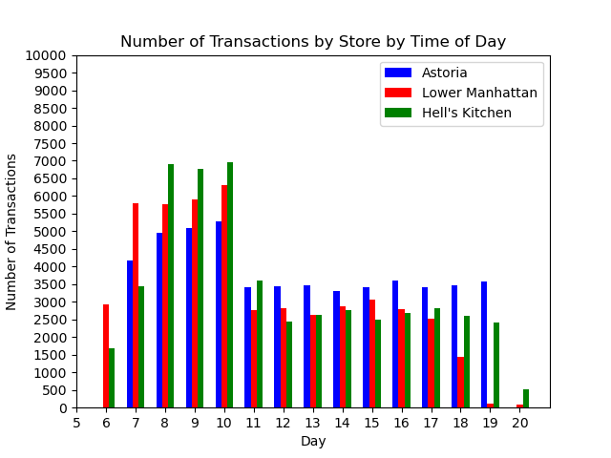
Hourly Transaction Analysis
Maven Coffee Shop's hourly transaction patterns reveal distinct trends across its Lower Manhattan, Hell's Kitchen, and Astoria locations. Lower Manhattan and Hell's Kitchen start the day at 6 AM, with Lower Manhattan experiencing its peak customer influx from 6 AM to 8 AM, aligning with the early morning business crowd. Hell's Kitchen, on the other hand, sees its highest transaction volume from 8 AM to 10 AM, possibly catering to a late-morning rush. Astoria, opening at 7 AM, initially shows the lowest morning numbers but experiences a significantly smaller decrease from 12 PM until closing, suggesting a preference for afternoon to evening patronage. Across all locations, there is a common trend of a rapid rise in transactions during the first few hours, maintaining high levels until 10 AM, followed by a notable drop from 11 AM until the evening, with activity dwindling to almost none by 8 PM.
The staffing needs for each Maven Coffee Shop location should be strategically aligned with these patterns. Lower Manhattan requires a strong early morning staff that can taper off post-lunch, while Hell's Kitchen needs to focus on maintaining adequate staffing levels from the morning until midday. Astoria, with its unique pattern, should ensure sufficient staffing during the afternoon and early evening hours. To capitalize on these varying customer flows, each location could implement specific business strategies: Lower Manhattan might extend its appeal with evening specials or events to retain post-work customers, Hell's Kitchen could introduce enticing breakfast options to draw the late morning crowd, and Astoria could explore lunchtime promotions or after-work deals to maximize its afternoon and evening potential. Such tailored approaches would ensure optimal utilization of resources, enhancing customer satisfaction and profitability.

Slide 11
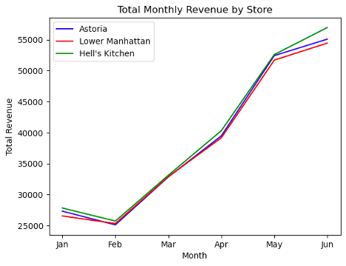
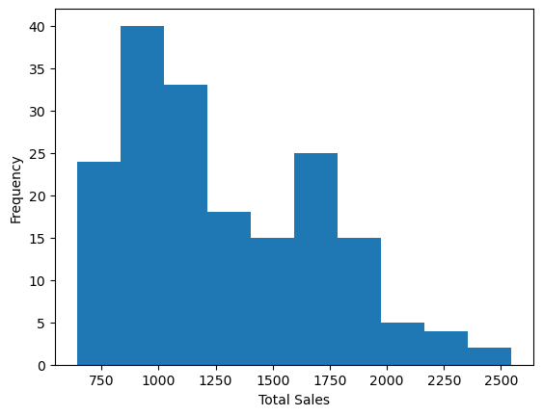
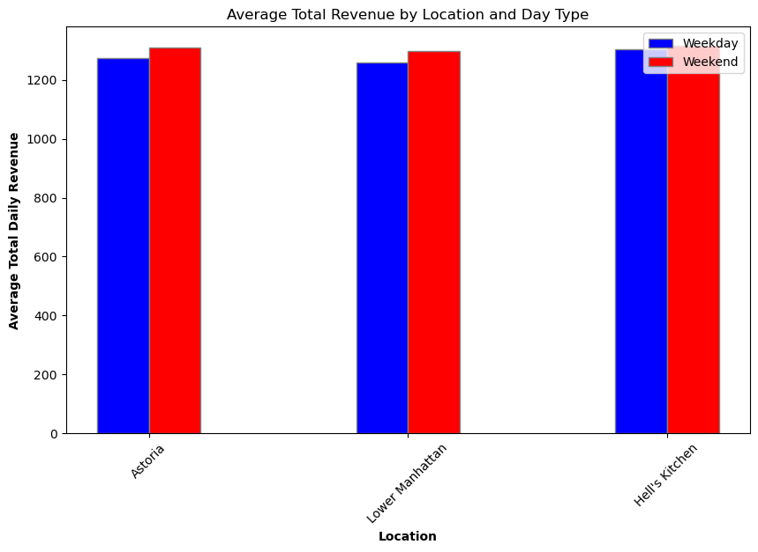
Top Performing Location: Total Revenue
Measure of central tendency: Median Monthly Revenue
Astoria: $36,156.52
Lower Manhattan: $36,024
Hell’s Kitchen: $36,606.36
No statistically significant differences
(Non-parametric tests - Kruskal Wallis)

Slide 12
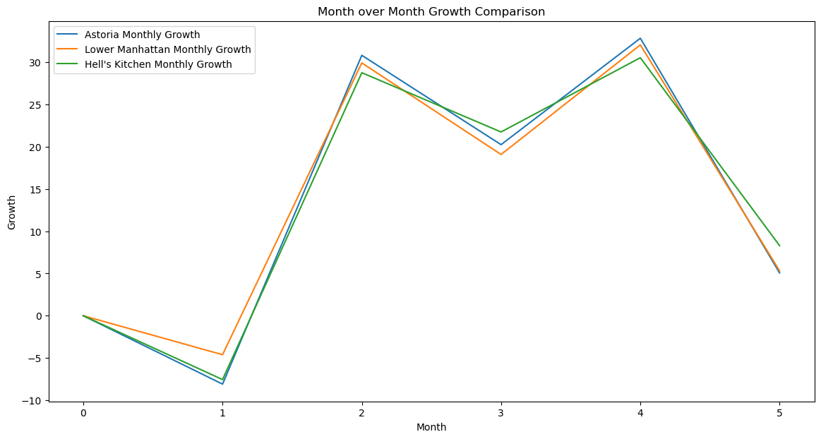
Top Performing Location: Growth Metrics
Measure of central tendency: Median Monthly Growth
Astoria: 12.64%
Lower Manhattan: 12.19%
Hell’s Kitchen: 15%
No statistically significant differences
(Non-parametric tests - Kruskal Wallis)

Slide 13
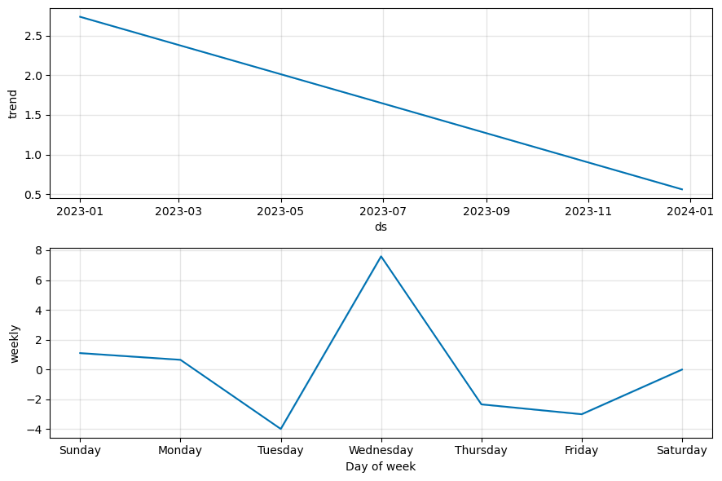
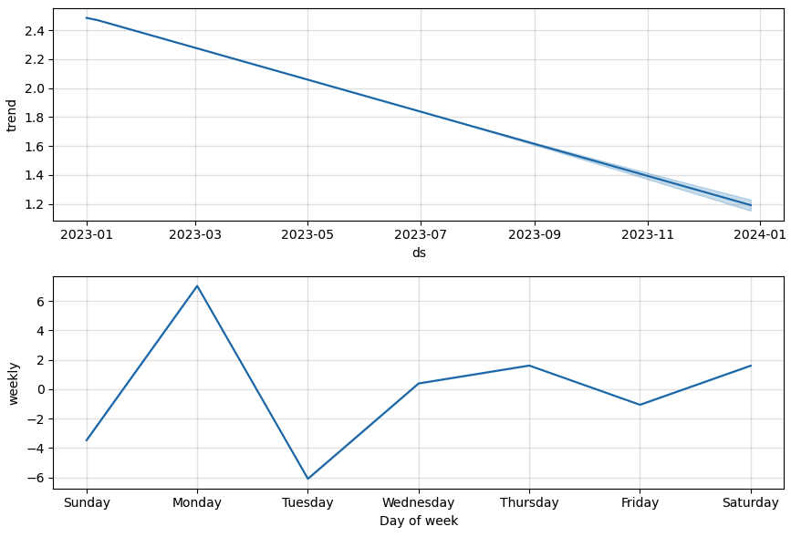
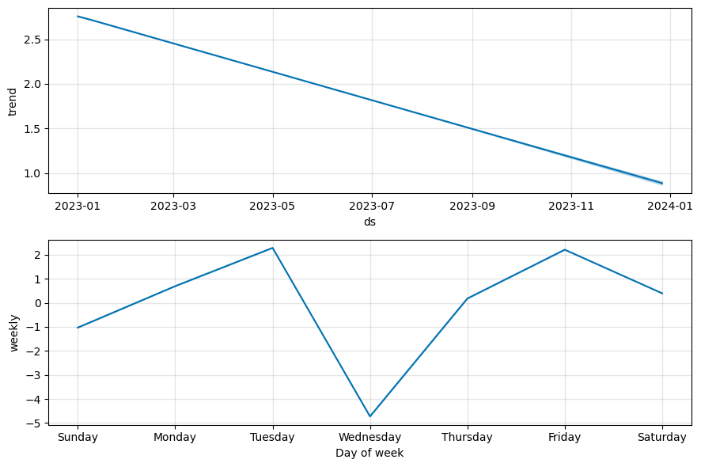
Top Performing Location: Growth Metrics cont.

Slide 14
Results and conclusions
Findings:
Key products driving sales
Customer footfall across locations and seasons
Profitable hours for each store
Tailored pricing
Staffing strategies
Conclusions:
Reevaluate metrics
Allocation of resources
Identify if location-specific attributes

Slide 15
Future Research and Development Plans:
Areas of interest:
Customer loyalty trends
New markets to identify opportunities for growth
Opportunities to employ advanced technologies
Development plan:
Integrate customer feedback
Market comparison studies

